Slide 1

Multilevel Monte Carlo methods
A topic for Efficient Computational Algorithms
Aditya Ujeniya
14th November 2022
With acknowledgements to Dr. Baroli and Dr. Multerer

Slide 2
Objectives
In presenting the Multi level Monte Carlo methods, we would like to see the emphasis on:
The simplicity of the idea by Stefan Heinrich, further extended by Mike Giles.
Flexibility of the approach
Variety of applications that people are working on.
In doing so, we will see this conceptually as well as numerically.

Slide 3
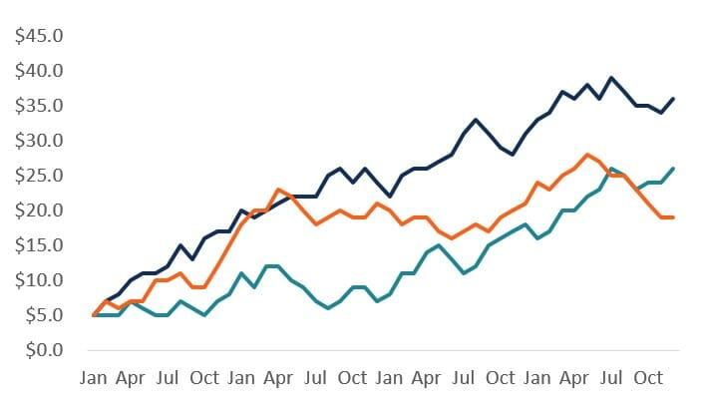
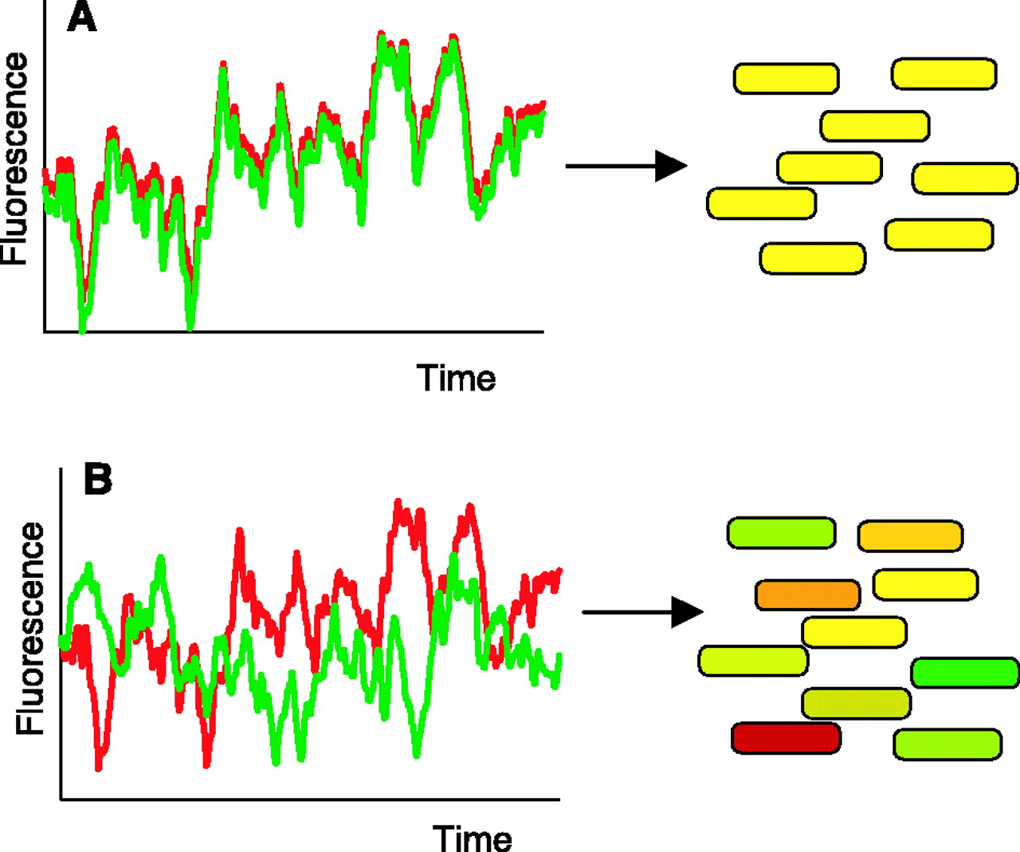
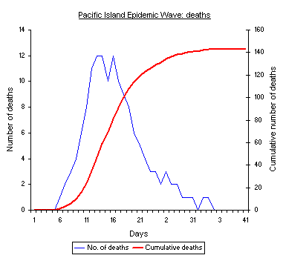
Motivation: Stochastic Systems in the Real World
Finance
Epidemics
Gene Expression

Slide 4







Example: SDE Path Simulation
We take an example of SDE(Stochastic Differential Equation) in finance, which in simpler case has this form:
where is the increment of Brownian motion, with variance .
This is usually approximated by Euler-Maruyama method:
with uniform timestep h, and increment factor with variance h.
The output of interest is a function of final value:
where is a scalar output.

Slide 5
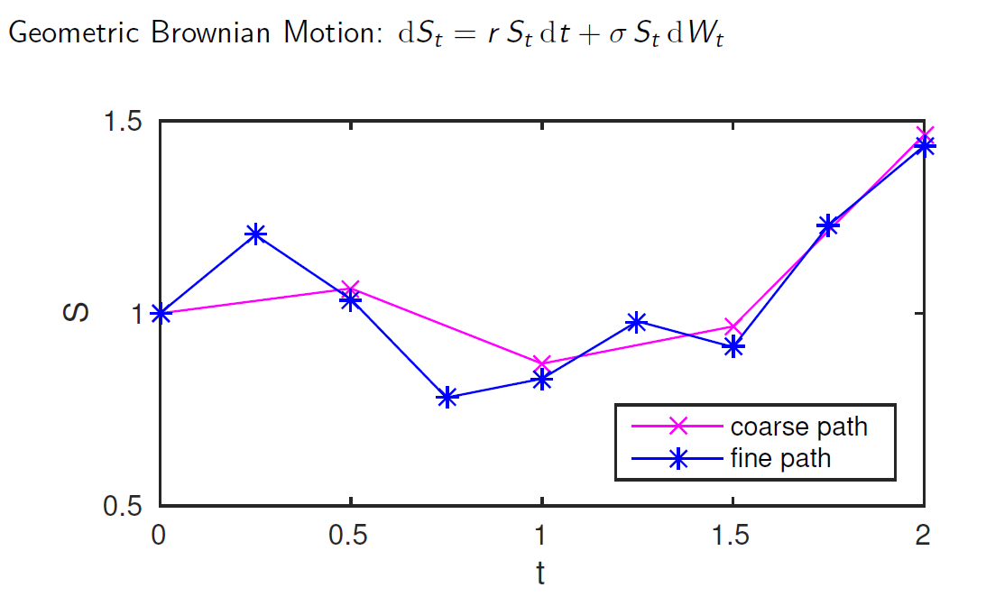
Example: SDE Path Simulation

Slide 6
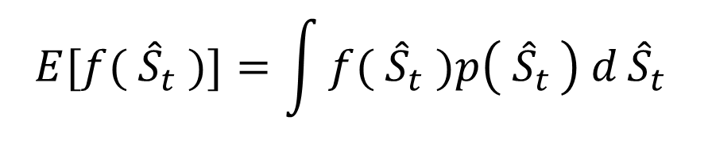
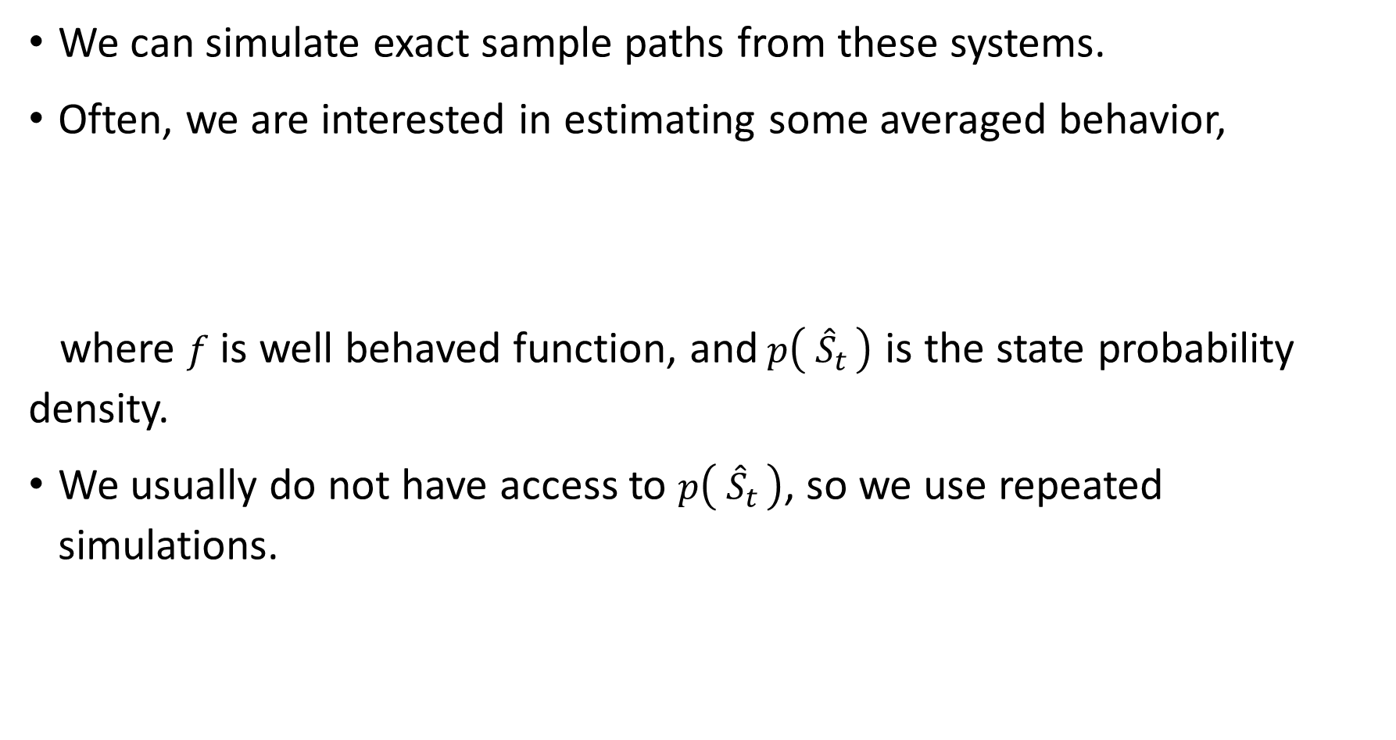
Exact Stochastic Simulation
We can simulate exact sample paths from these systems.
Often, we are interested in estimating some averaged behavior,
where $f$ is well behaved function, and$p\left( {\hat{S}}_{t }\right)$ is the state probability density.
We usually do not have access to $p\left( {\hat{S}}_{t }\right)$, so we use repeated simulations.
$$E[{f( \hat{S}}_{t} )]=\int{{f( \hat{S}}_{t} )p\left( {\hat{S}}_{t }\right) d}{\hat{S}}_{t}$$

Slide 7
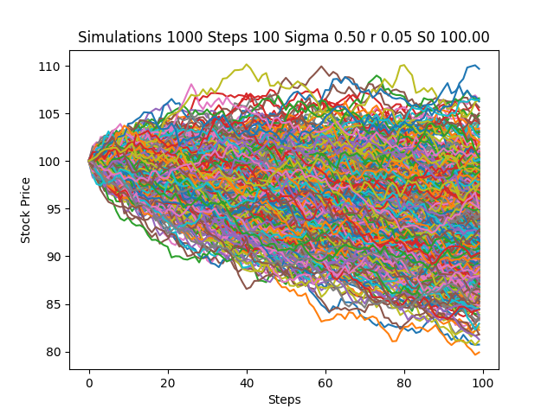
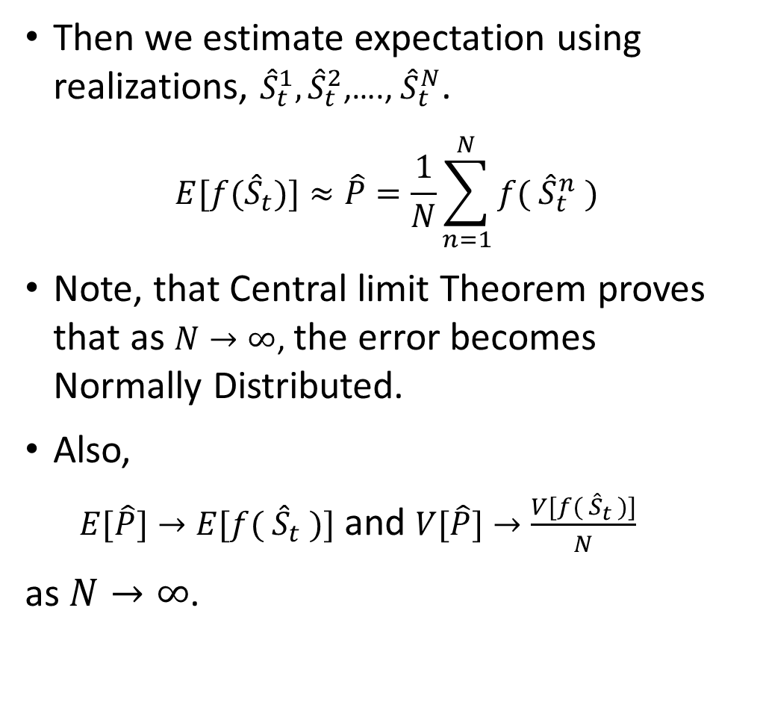
Monte Carlo Methods
Then we estimate expectation using realizations, ${\hat{S}}_{t}^{1},{\hat{S}}_{t}^{2}$,…., ${\hat{S}}_{t}^{N}$.
$$E[{f(\hat{S}}_{t})]≈\hat{P}=\frac{1}{N}\sum_{n=1}^{N}{f({ \hat{S}}_{t}^{n} )}$$
Note, that Central limit Theorem proves that as $N→∞$, the error becomes Normally Distributed.
Also,
$E[\hat{P}]→E[{f( \hat{S}}_{t} )]$ and $V[\hat{P}]→\frac{V[{f( \hat{S}}_{t} )]}{N}$
as $N→∞$.

Slide 8
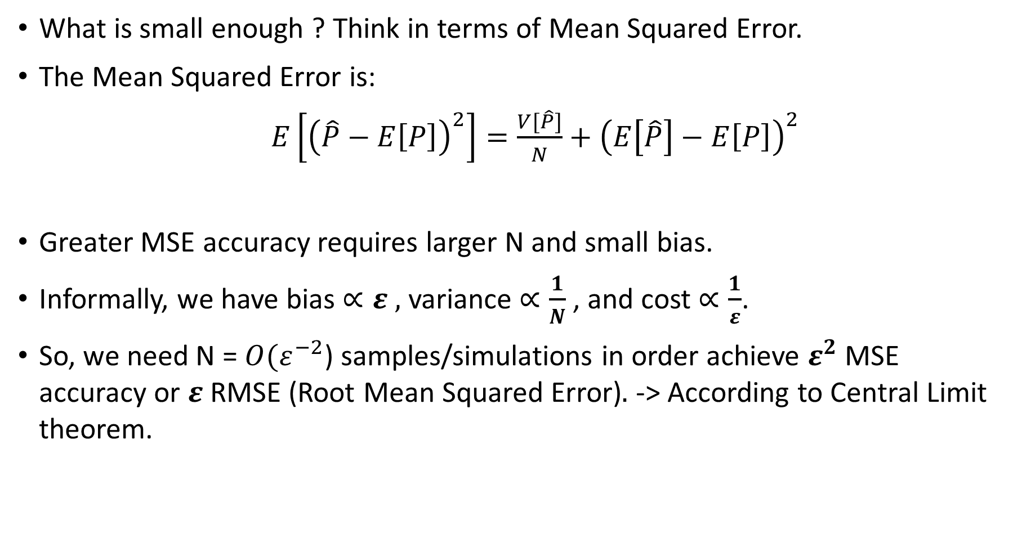
Computational Challenge
What is small enough ? Think in terms of Mean Squared Error.
The Mean Squared Error is:
$E\left[{\left(\hat{P}−E\left[P\right]\right)}^{2}\right]=\frac{V[\hat{P}]}{N}+{\left(E\left[\hat{P}\right]−E\left[P\right]\right)}^{2}$
Greater MSE accuracy requires larger N and small bias.
Informally, we have bias $∝ε ,$ variance $∝\frac{1}{N}$, and cost $∝\frac{1}{ε}$.
So, we need N = ${O(ε}^{−2}$) samples/simulations in order achieve $ε^{2}$ MSE accuracy or $ε$RMSE (Root Mean Squared Error)$.$ -> According to Central Limit theorem.
Variance Bias

Slide 9
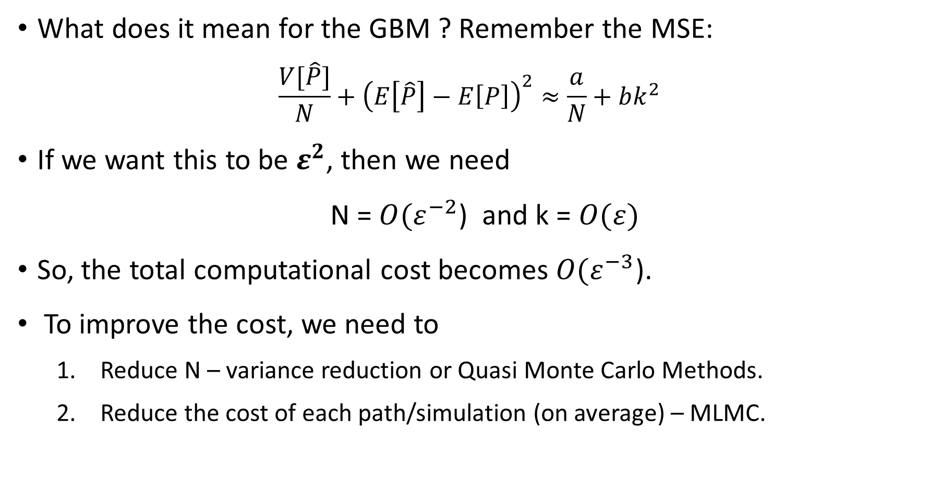
Computational Challenge
What does it mean for the GBM ? Remember the MSE:
$$\frac{V[\hat{P}]}{N}+{\left(E\left[\hat{P}\right]−E\left[P\right]\right)}^{2}≈\frac{a}{N}+bk^{2}$$
If we want this to be $ε^{2}$, then we need
N = ${O(ε}^{−2}$) and k = $O(ε)$
So, the total computational cost becomes ${O(ε}^{−3}$).
To improve the cost, we need to
Reduce N – variance reduction or Quasi Monte Carlo Methods.
Reduce the cost of each path/simulation (on average) – MLMC.

Slide 10
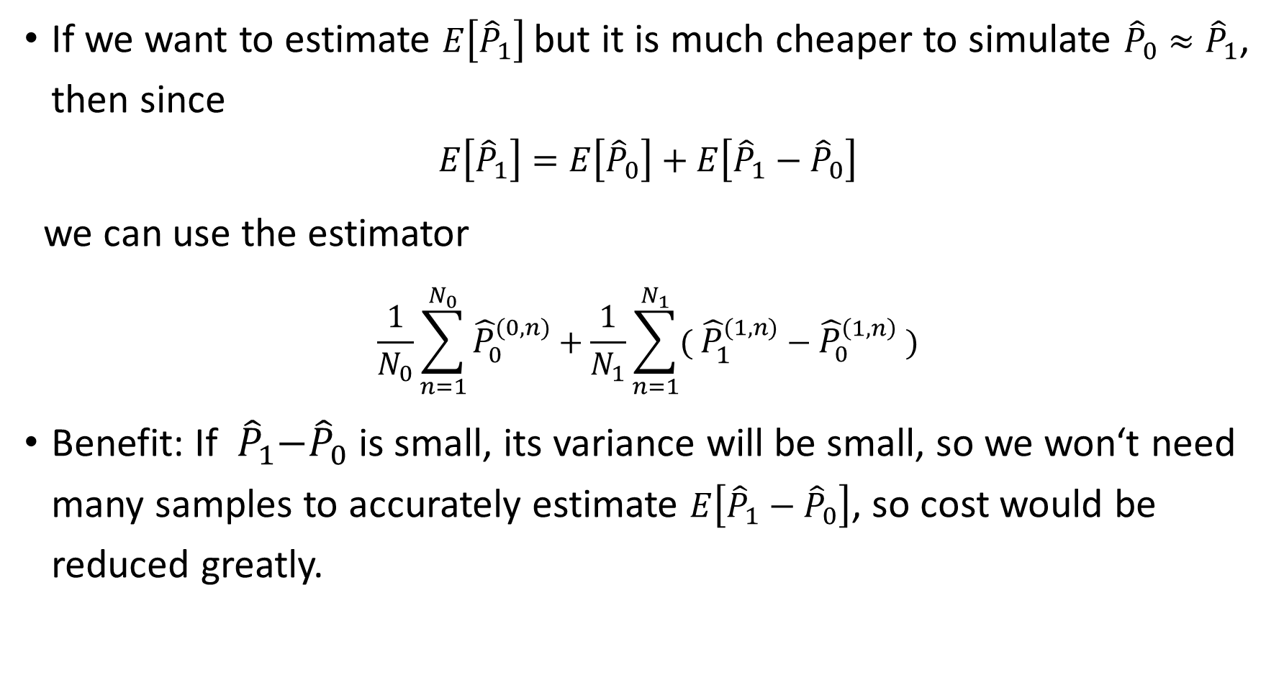
Two-level Monte Carlo
If we want to estimate $E\left[{\hat{P}}_{1}\right]$ but it is much cheaper to simulate ${\hat{P}}_{0}≈{\hat{P}}_{1}$, then since
$$E\left[{\hat{P}}_{1}\right]=E\left[{\hat{P}}_{0}\right]+E\left[{\hat{P}}_{1}−{\hat{P}}_{0}\right]$$
we can use the estimator
$$\frac{1}{N_{0}}\sum_{n=1}^{N_{0}}{{\hat{P}}_{0}^{(0,n)}}+\frac{1}{N_{1}}\sum_{n=1}^{N_{1}}{{( \hat{P}}_{1}^{(1,n)} −{ \hat{P}}_{0}^{\left(1,n\right)} )}$$
Benefit: If${ \hat{P}}_{1}−{\hat{P}}_{0}$ is small, its variance will be small, so we won‘t need many samples to accurately estimate $E\left[{\hat{P}}_{1}−{\hat{P}}_{0}\right]$, so cost would be reduced greatly.

Slide 11
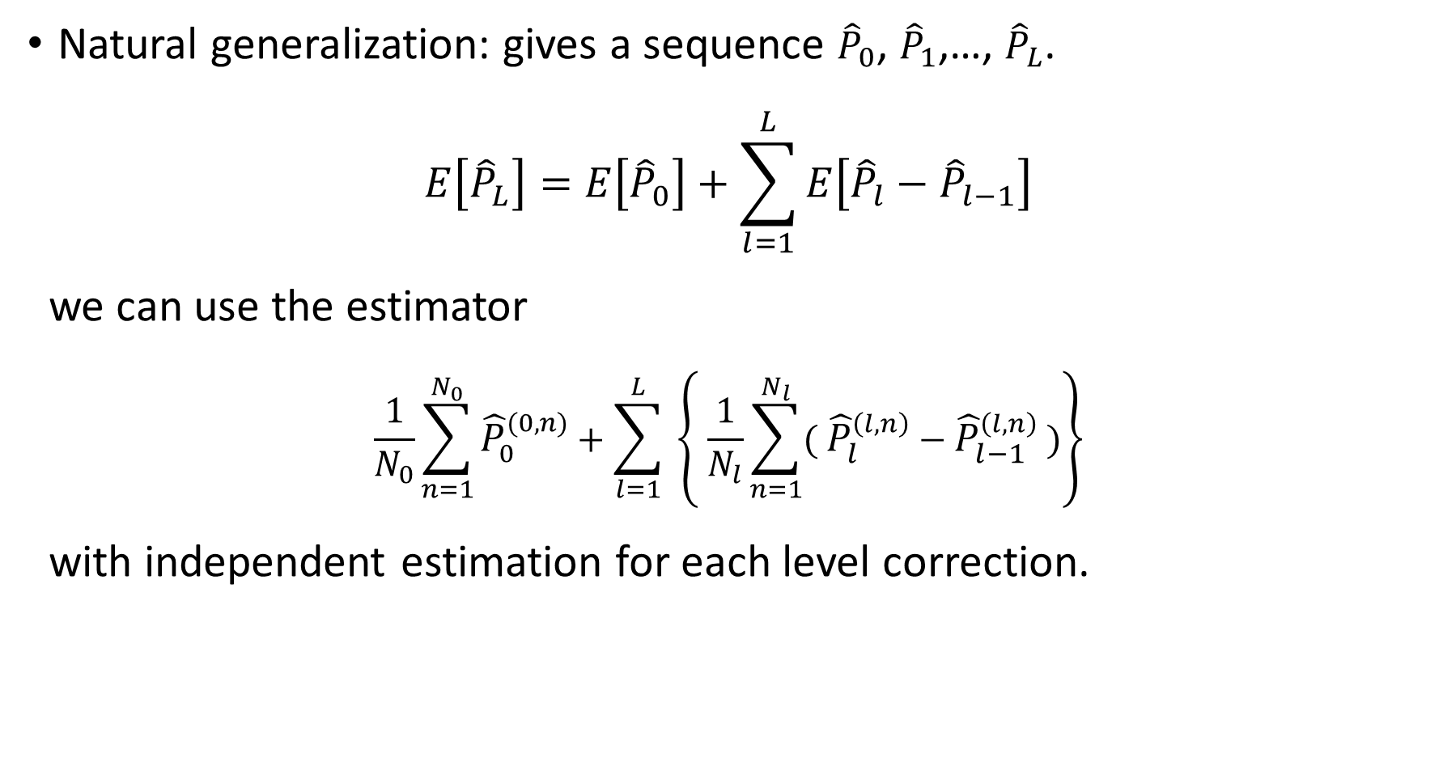
Multi-level Monte Carlo
Natural generalization: gives a sequence ${\hat{P}}_{0}$, ${\hat{P}}_{1}$,…, ${\hat{P}}_{L}$.
$$E\left[{\hat{P}}_{L}\right]=E\left[{\hat{P}}_{0}\right]+\sum_{l=1}^{L}{E\left[{\hat{P}}_{l}−{\hat{P}}_{l−1}\right]}$$
we can use the estimator
$$\frac{1}{N_{0}}\sum_{n=1}^{N_{0}}{{\hat{P}}_{0}^{(0,n)}}+\sum_{l=1}^{L}{ \left\{ \frac{1}{N_{l}}\sum_{n=1}^{N_{l}}{{( \hat{P}}_{l}^{\left(l,n\right)} −{ \hat{P}}_{l−1}^{\left(l,n\right)} )}\right\}}$$
with independent estimation for each level correction.

Slide 12

Key Idea: Multilevel Telescoping Sum
For $l=0, 1,…, L$, denote${ \hat{P}}_{L}$ as an approximation to $P$using $τ_{l}∝ m^{−l}$.
$E[P]≈E[{\hat{P}}_{L}]$
$=E[{\hat{P}}_{L−1}]+E[{\hat{P}}_{L}−{\hat{P}}_{L−1}$]
$=E[{\hat{P}}_{L−2}]+E[{\hat{P}}_{L−1}−{\hat{P}}_{L−2}]+E[{\hat{P}}_{L}−{\hat{P}}_{L−1}]$
$=E[{\hat{P}}_{0}]+\sum_{l=1}^{L}{E[{\hat{P}}_{l}−{\hat{P}}_{l−1}]}$
Low bias approximation
Slightly biased approximation
Bias correction
Slightly more biased approximation
Two bias correction
.
.
.
L bias correction
Very biased approximation

Slide 13
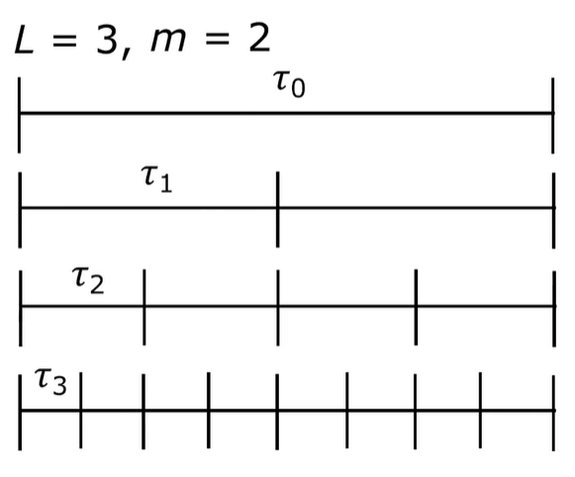

Key Idea: Multilevel Telescoping Sum
For $l=0, 1,…, L$, denote ${\hat{S}}_{l, t }$ as an approximation to $S_{t }$using $τ_{l}∝ m^{−l}$.

Slide 14
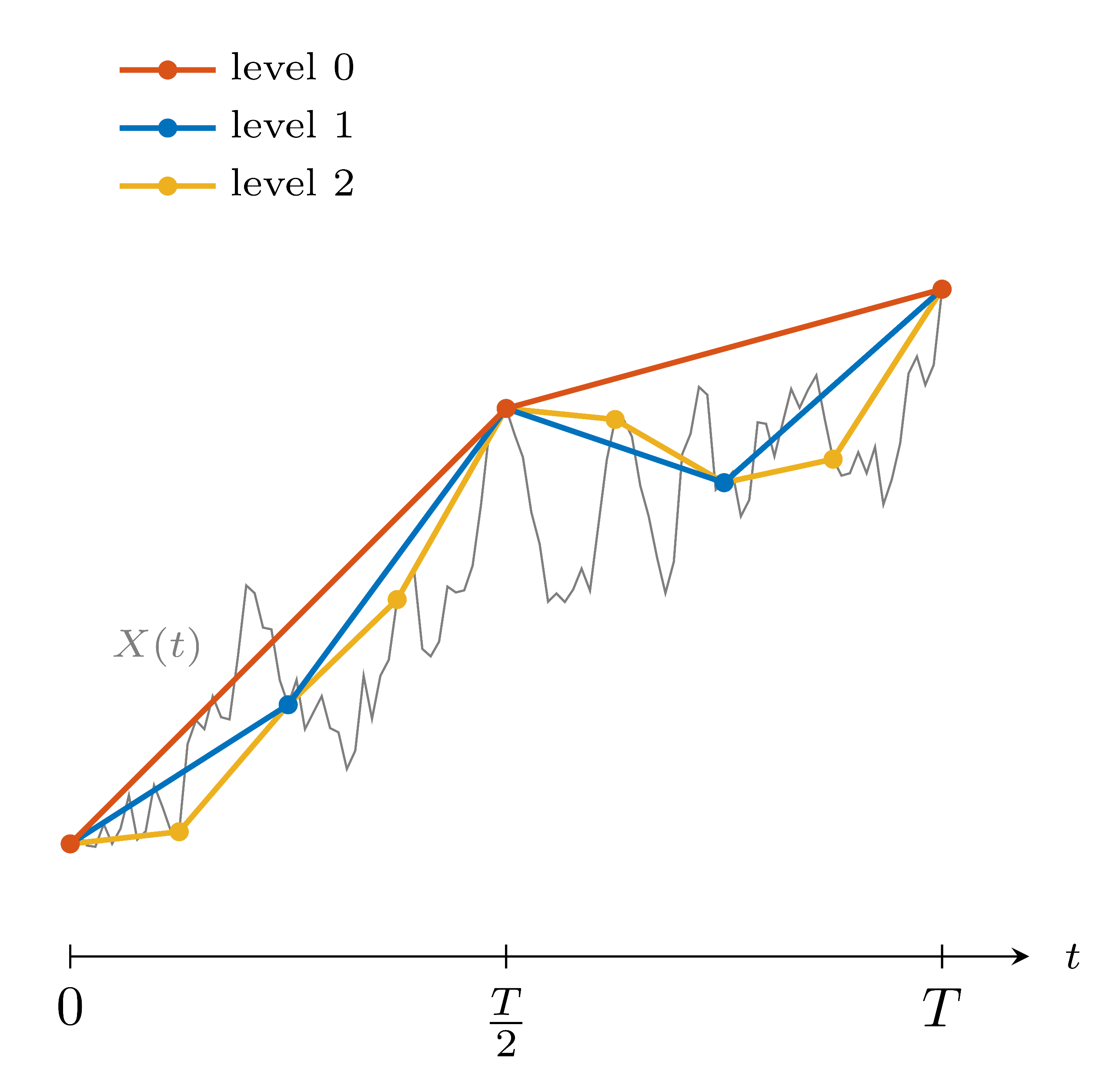
Key Idea: Multilevel Telescoping Sum

Slide 15
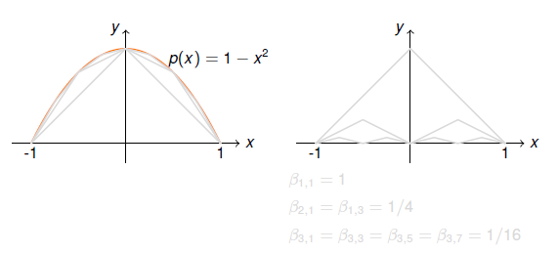
Hierarchical Basis for Approximations

Slide 16
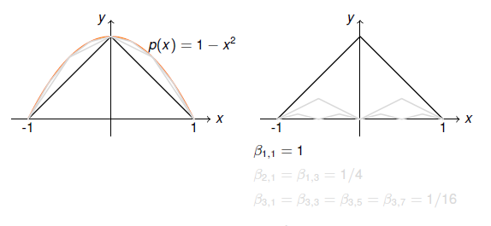
Hierarchical Basis for Approximations

Slide 17
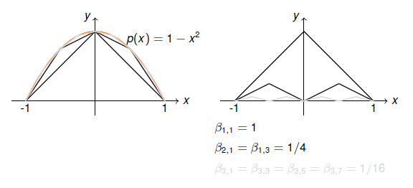
Hierarchical Basis for Approximations

Slide 18
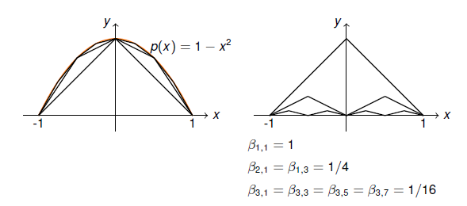
Hierarchical Basis for Approximations

Slide 19
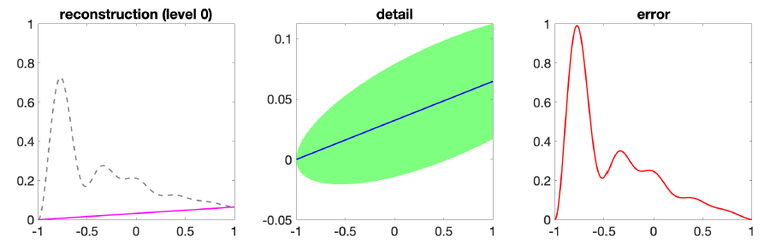
Hierarchical Basis for Approximations

Slide 20
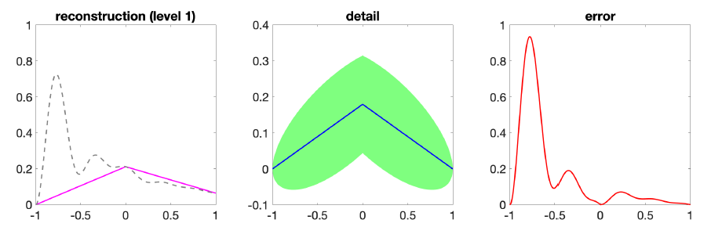
Hierarchical Basis for Approximations

Slide 21
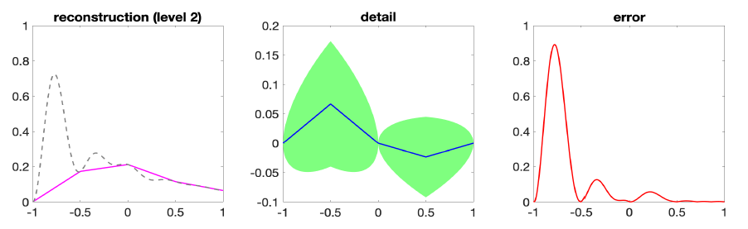
Hierarchical Basis for Approximations

Slide 22
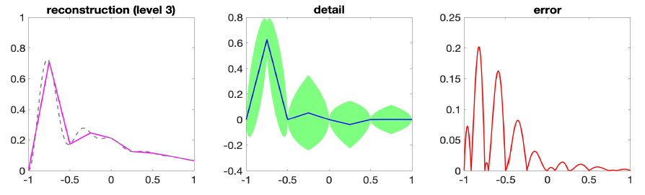
Hierarchical Basis for Approximations

Slide 23
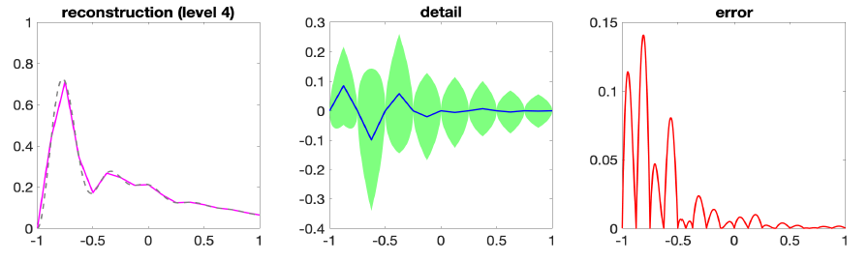
Hierarchical Basis for Approximations

Slide 24
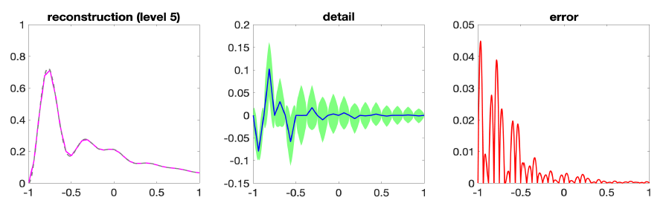
Hierarchical Basis for Approximations

Slide 25
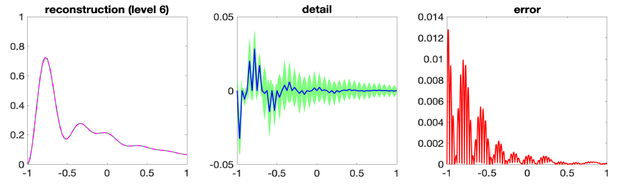
Hierarchical Basis for Approximations

Slide 26
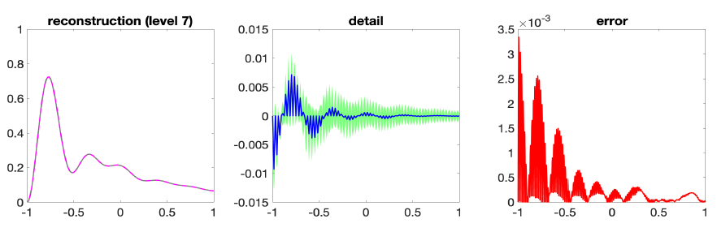
Hierarchical Basis for Approximations

Slide 27
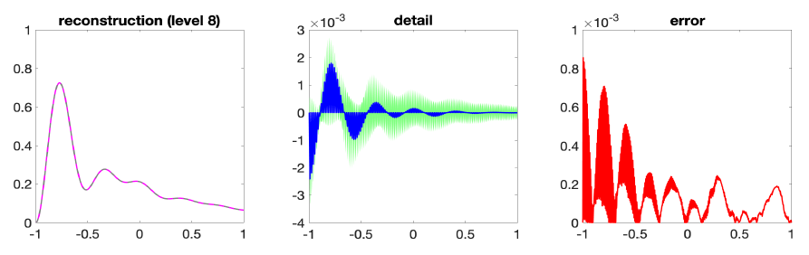
Hierarchical Basis for Approximations

Slide 28
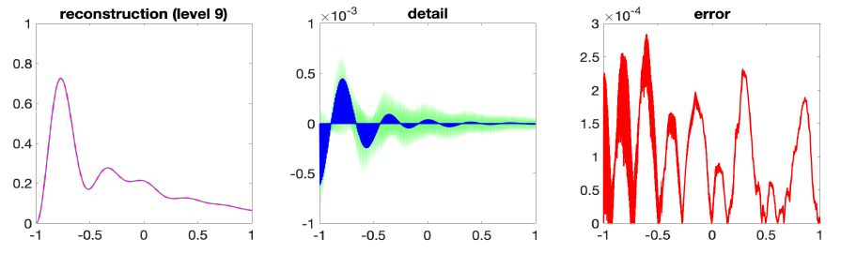
Hierarchical Basis for Approximations

Slide 29
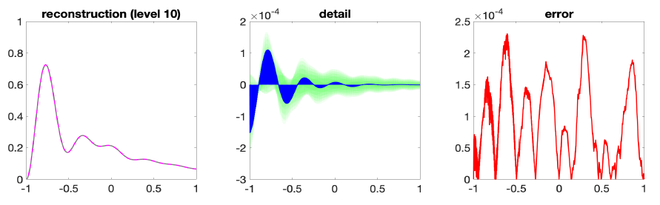
Hierarchical Basis for Approximations

Slide 30
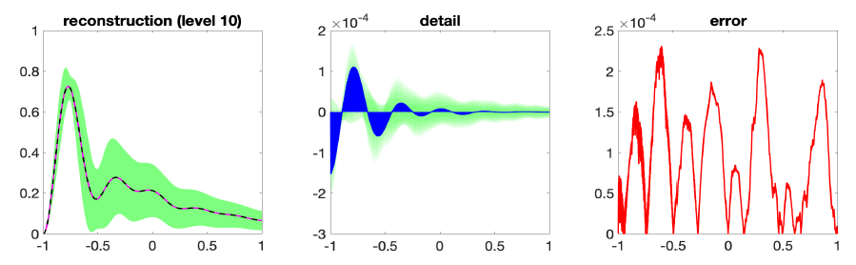
Hierarchical Basis for Approximations

Slide 31
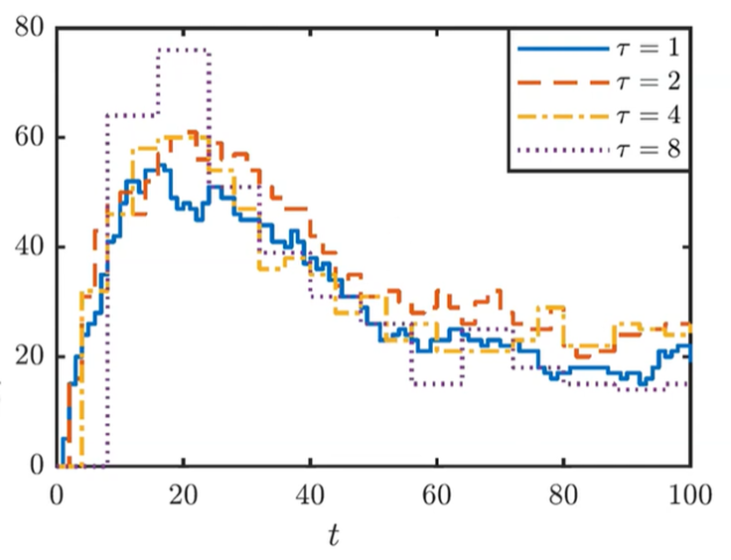
Sampling by given interval

Slide 32

Variance Reduction and Optimal Sample Sizes
This scheme induces a positive correlation between (${ \hat{P}}_{l}^{\left(n\right)} −{ \hat{P}}_{l−1}^{\left(n\right)}$) path pairs.
Recall: for correlated r.v. V$\left[X−Y\right]=V\left[X\right]+V\left[Y\right]−C\left[X,Y\right].$
That is we get a variance reduction in the correction estimator.
$${\hat{Y}}_{l}=\frac{1}{N_{l}}\sum_{n=1}^{N_{l}}{{( \hat{P}}_{l}^{\left(n\right)} −{ \hat{P}}_{l−1}^{\left(n\right)})}$$
If we define
$C_{0},V_{0}$ to be cost and variance of ${\hat{P}}_{0}$.
$C_{l},V_{l}$ to be cost and variance of ${\hat{P}}_{l}$ - ${\hat{P}}_{l−1}$.
then the total cost is $\sum_{l=0}^{L}{N_{l}C_{l}}$ and the variance is $\sum_{l=0}^{L}{\frac{1}{N_{l}}}$ $V_{l}$.

Slide 33

Variance Reduction and Optimal Sample Sizes
For target MSE $∝ε^{2}$, we can optimize choice of L and $N_{l}$ for $l=0,1,…,L.$
Choose $N_{l}∝ \sqrt{\frac{C_{l}}{V_{l}}}$ so that total variance is less than $\frac{1}{2}$ $ε^{2}$.
Choose L so that ${\left( E\left[{\hat{P}}_{L}\right]−E\left[P\right] \right)}^{2}<\frac{1}{2}$ $ε^{2}$.

Slide 34
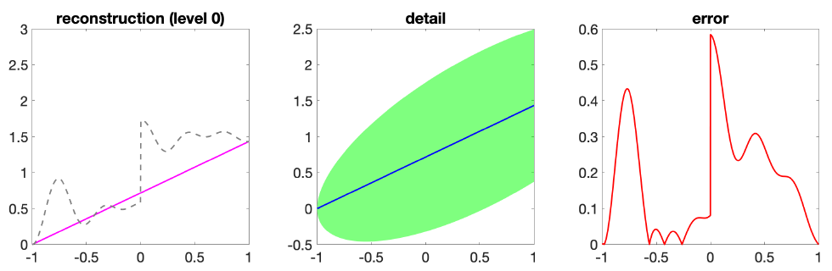
Time for caution

Slide 35
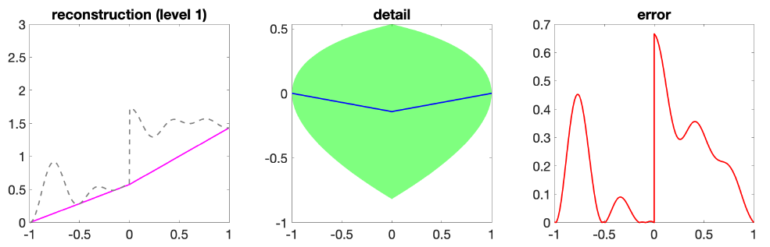
Time for caution

Slide 36
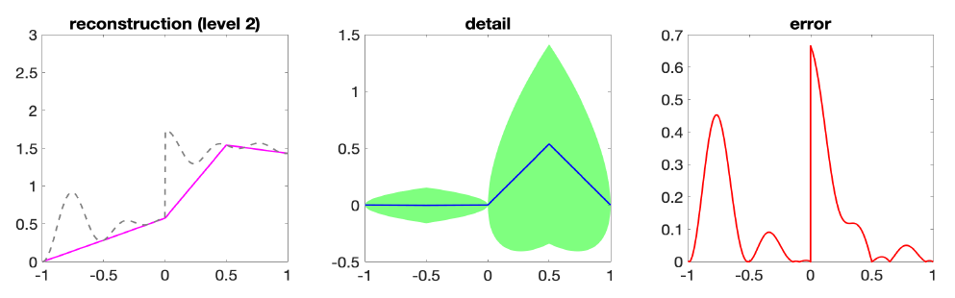
Time for caution

Slide 37
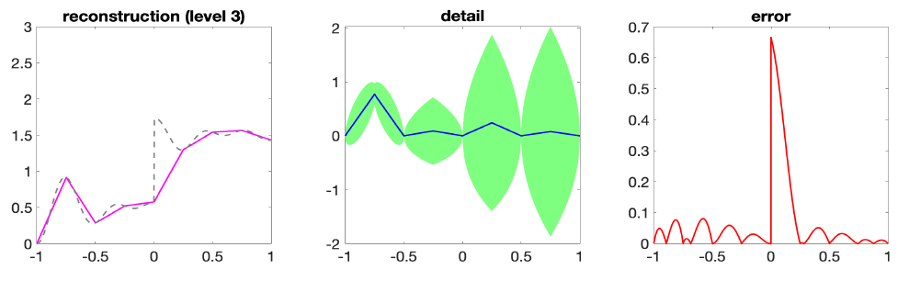
Time for caution

Slide 38
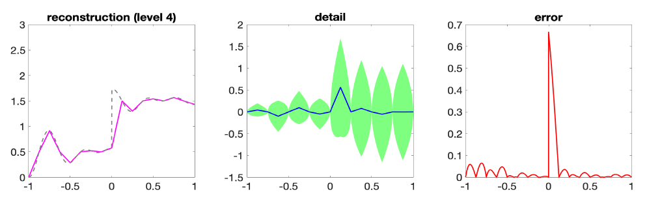
Time for caution

Slide 39
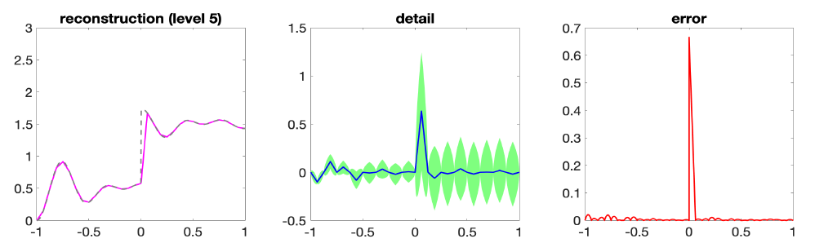
Time for caution

Slide 40
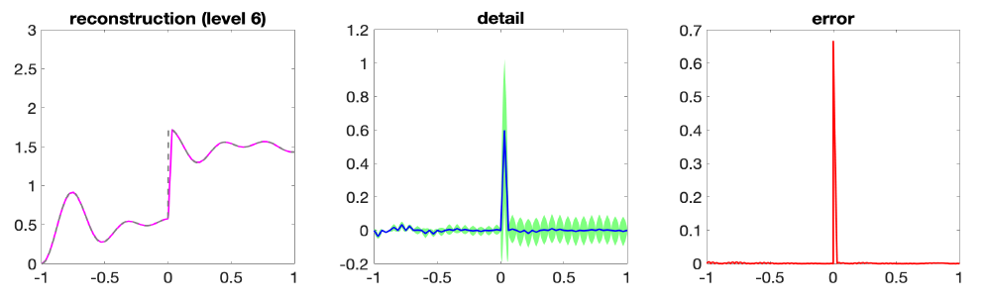
Time for caution

Slide 41
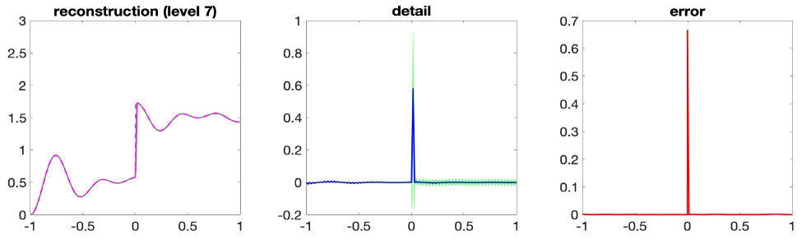
Time for caution

Slide 42
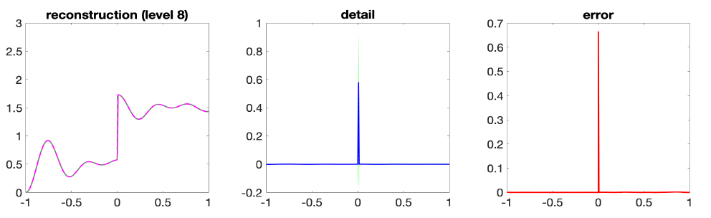
Time for caution

Slide 43
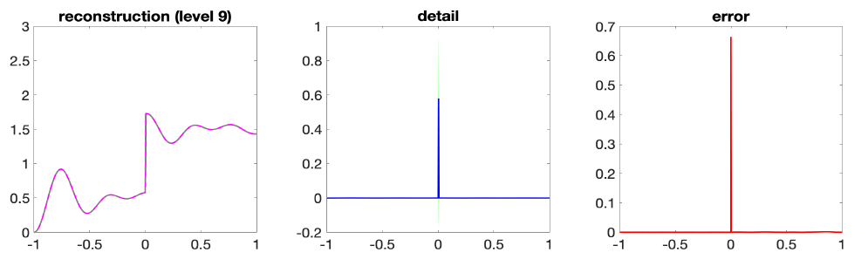
Time for caution

Slide 44
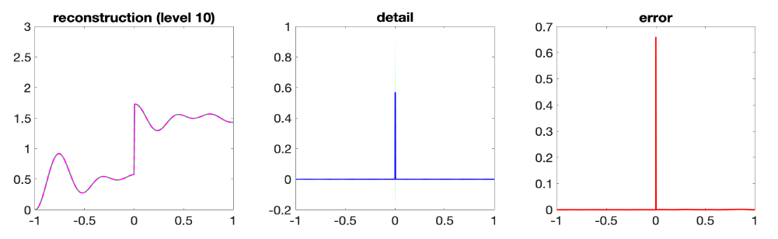
Time for caution

Slide 45
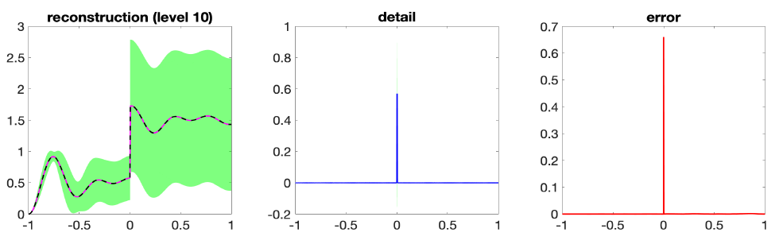
Time for caution
If the spatial details do not decay, then the multilevel Monte Carlo method does not yield convergence.

Slide 46
Mixed precision computing
As more examples of the flexibility of the MLMC approach, the levels can correspond to different levels of computing precision
2ℓ+2 bits of precision on level ℓ when using FPGAs (Korn, Ritter,Wehn, 2014)
IEEE half-precision on level 0, IEEE single precision on level1, etc., when computing on CPUs or GPUs
or the different levels can use different random number generators
level 0: 10-bit uniform random numbers, with table lookup to convert to approximate Normals
level 1: 32-bit uniform random numbers, and more complex calculation to obtain Normals

Slide 47
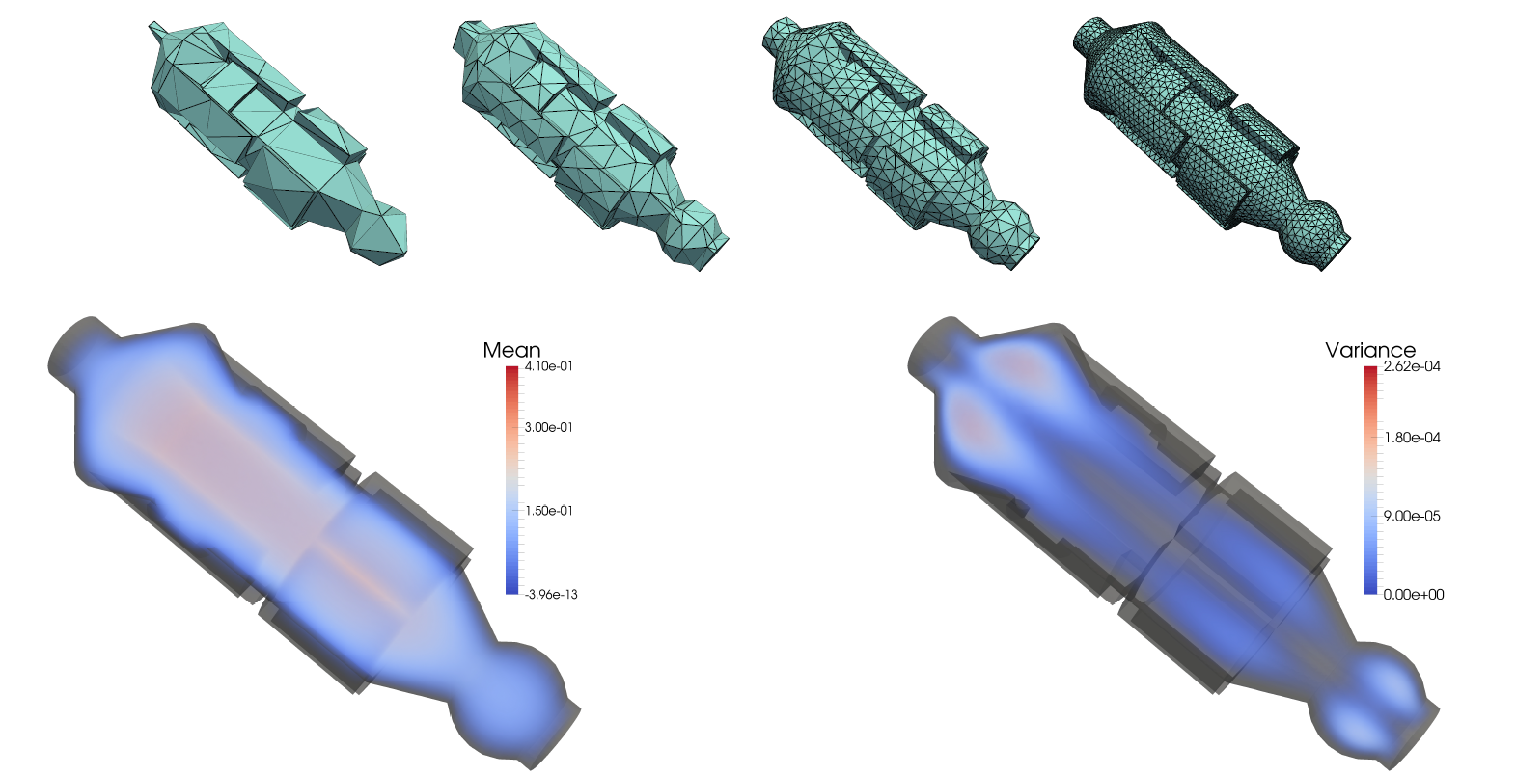
Random Diffusion Problem

Slide 48
Other MLMC Applications
Multilevel QMC (G, Waterhouse 2009, Dick, Kuo, Scheichl, Schwab, Sloan, 2014-18)
MLMC for MCMC (Schwab & Stuart, 2013; Scheichl & Teckentrup, 2015)
Stochastic chemical reactions (Anderson & Higham, 2012, 2014)
Invariant distribution of contractive Markov process (Glynn & Rhee)
Invariant distribution of contractive SDEs (G, Lester & Whittle)

Slide 49

Further extension for MLMC Simulation
Multi-index Monte Carlo – Haji-Ali, Nobile, Tempone (2015)
-> important extension to MLMC approach, combining MLMC with sparse grid methods (combination technique).
Standard “1D” MLMC truncates the telescopic sum
$E\left[P\right]= \sum_{l=0}^{∞}{E[∆{\hat{P}}_{l}]}$
where $∆{\hat{P}}_{l}$ = ${\hat{P}}_{l}−{\hat{P}}_{l−1}$ with ${\hat{P}}_{−1}=0.$
In “2D”, MIMC truncates the telescoping sum
$E\left[P\right]= \sum_{l1=0}^{∞}{\sum_{l2=0}^{∞}{E[∆{\hat{P}}_{l1, l2}]}}$
where $∆{\hat{P}}_{l1, l2}$= ${(\hat{P}}_{l1, l2}−{\hat{P}}_{l1−1, l2}) −{(\hat{P}}_{l1, l2−1}−{\hat{P}}_{l1−1, l2−1}).$

Slide 50
Conclusion
Multilevel idea is very simple; key question is how to apply it in new situations, and how to carry out the numerical analysis
Discontinuous output functions can cause problems, but there is a lot of new techniques to cope up with it.
Being used for an increasingly wide range of applications; biggest computational savings when coarsest (reasonable) approximation is much cheaper than finest.
Currently, getting at least 100× savings for SPDEs and stochastic chemical reaction simulations

Slide 51
References
https://www.youtube.com/watch?v=zK1ghzLbrgI
https://www.youtube.com/watch?v=PzrP6HGUAio
https://people.maths.ox.ac.uk/gilesm/files/OPRE_2008.pdf
https://en.wikipedia.org/wiki/Multilevel_Monte_Carlo_method
https://www.uni-kl.de/AG-Heinrich/papers/mmcm01.pdf
https://people.maths.ox.ac.uk/gilesm/files/acta15.pdf
https://eta.impa.br/dl/135.pdf

